Slide 1

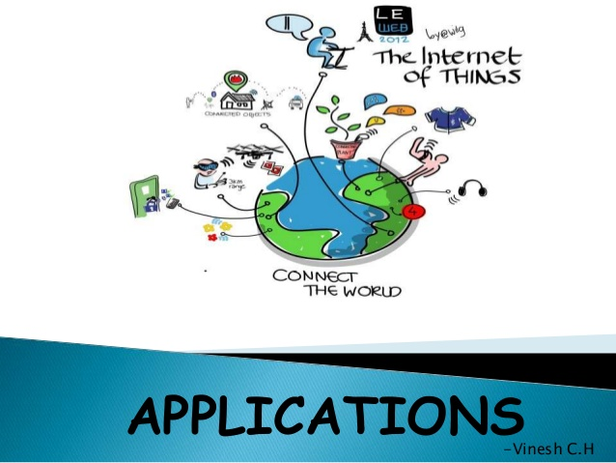
B.N.M. Institute of Technology Approved by AICTE, Affiliated to VTU, Accredited as grade A Institution by NAAC. All UG branches – CSE, ECE, EEE, ISE & Mech.E accredited by NBA for academic years 2018-19 to 2020-21 & valid upto 30.06.2021 Post box no. 7087, 27th cross, 12th Main, Banashankari 2nd Stage, Bengaluru- 560070, INDIA Ph: 91-80- 26711780/81/82 Email: principal@bnmit.in, www. bnmit.org
SKILL DEVELOPMENT PROGRAMME
on
Internet of Things
Organized by
Department of Computer Science & Engineering

Slide 2
IoT Protocols Classification
IoT protocols can be generally classified into two broad classes:
Infrastructure Protocols
Messaging Protocols

Slide 3
COAP
Its is the most recent application layer convention created by IETF for savvy gadgets to interface with internet.
Lightweight convention CoAP is expected to be utilized and considered as a trade of HTTP for being an IoT application layer convention.

Slide 4
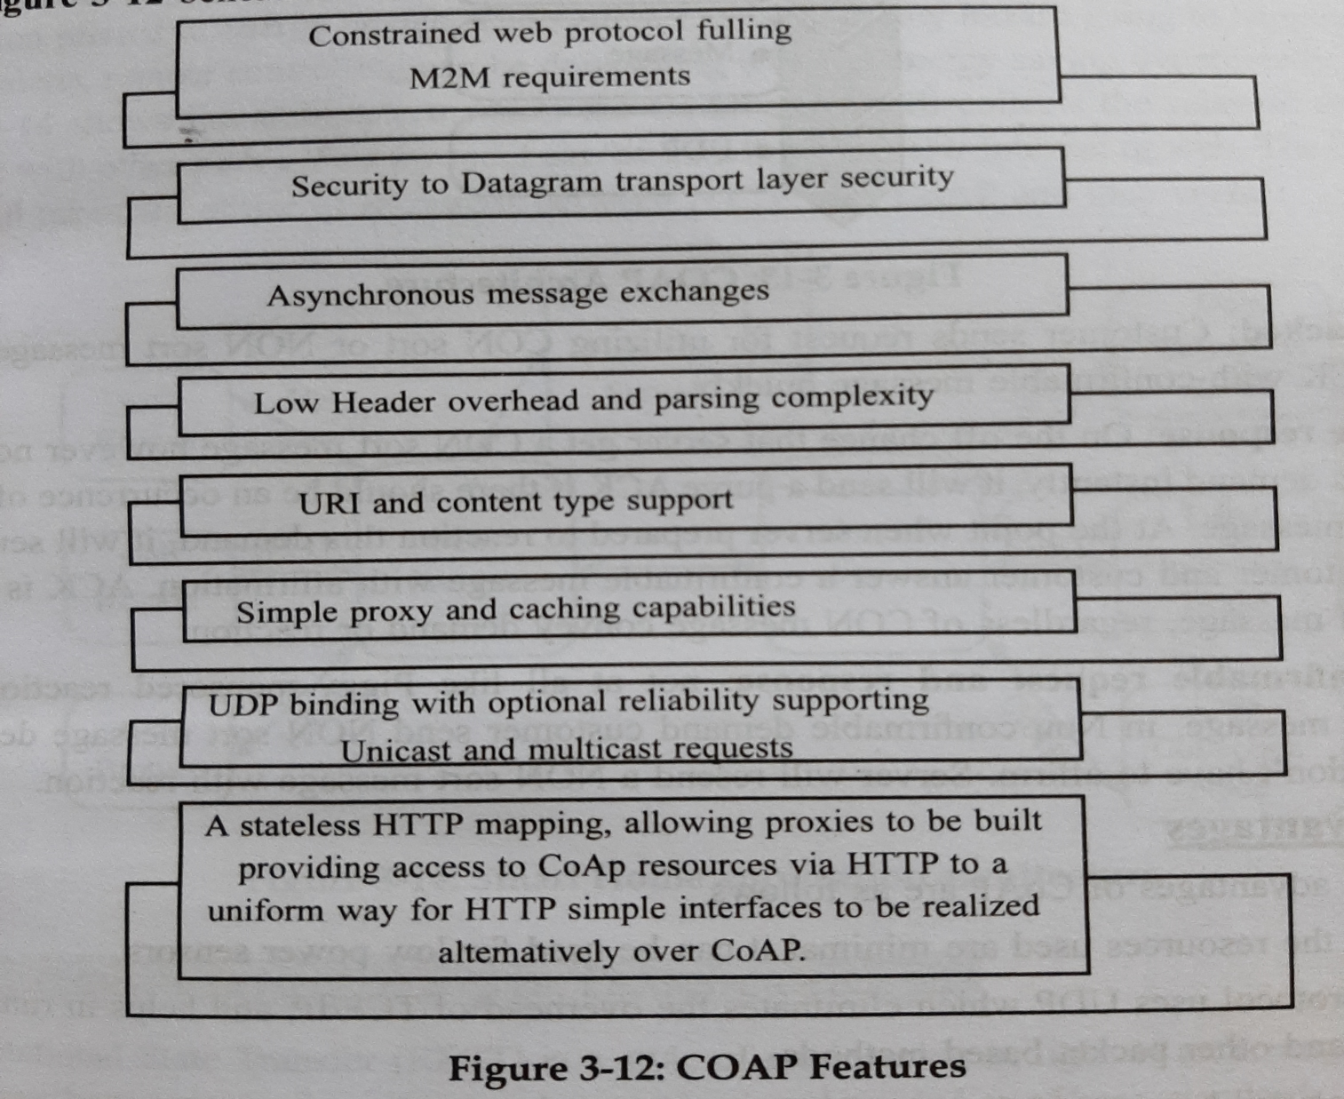
Features of CoAP

Slide 5
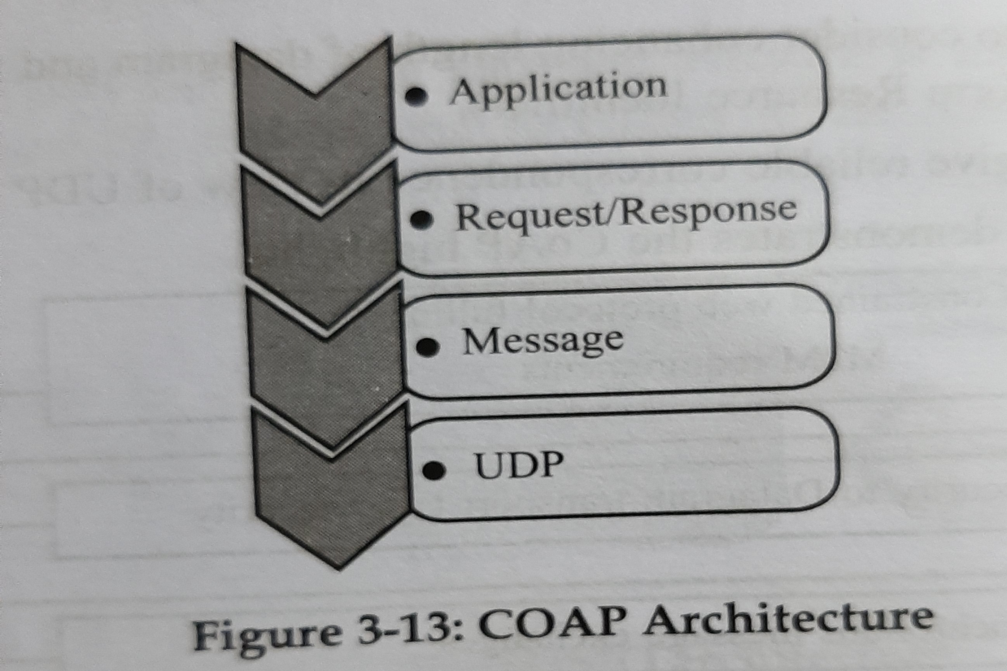
CoAP Architecture
a) Piggy-Backed
b) Separate response
c) Non Confirmable request and response

Slide 6
Advantages of CoAP
Resources used are minimal
It is secured.
Multicast requirement
Asynchronous communication

Slide 7
Security Protocol and Application for CoAP
DTLS take care of two issues:
Reordering
Bundle lost
DTLS includes three executes:
Bundle retransmission
Doling out
Replay location

Slide 8
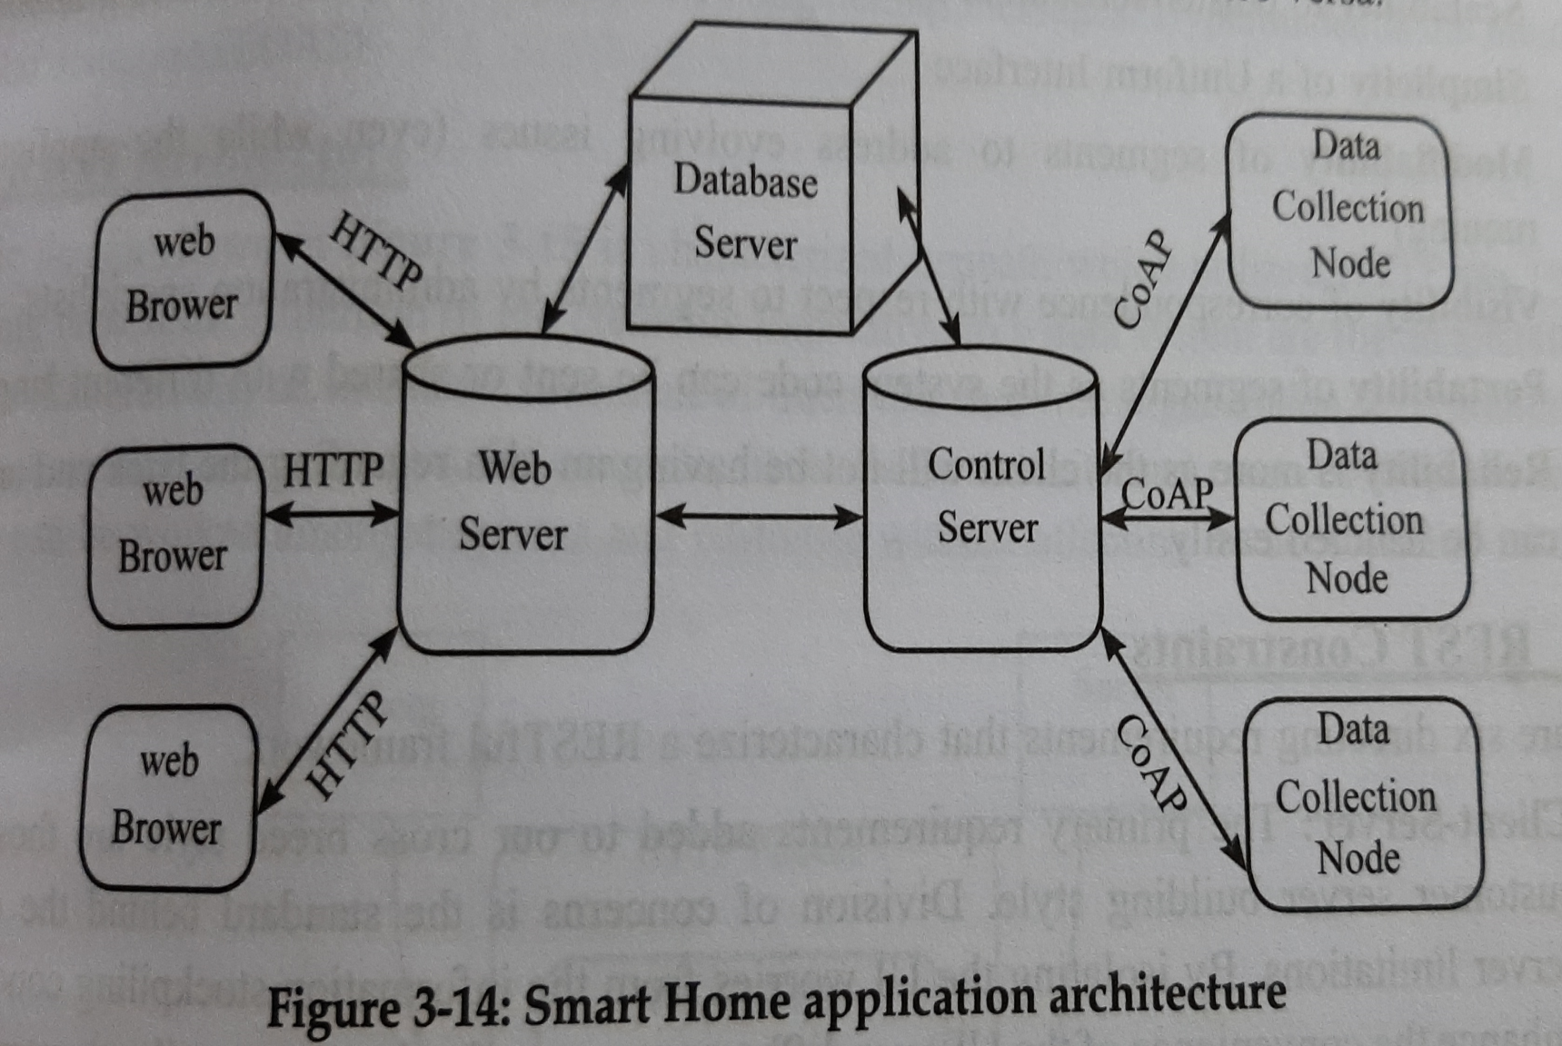
Smart Homes Application Architecture

Slide 9
Representational State Transfer (REST)
REST is a contrasting option to SOAP and JSON.
REST has turned out to be a famous decision for actualizing Web Services.

Slide 10
REST Architectural Properties
Performance
Scalability
Simplicity
Modifiability
Visibility
Portability
Reliability

Slide 11
REST Constraints
Client- Server
Stateless
Cacheable
Layered framework
Code on request
Uniform interface

Slide 12
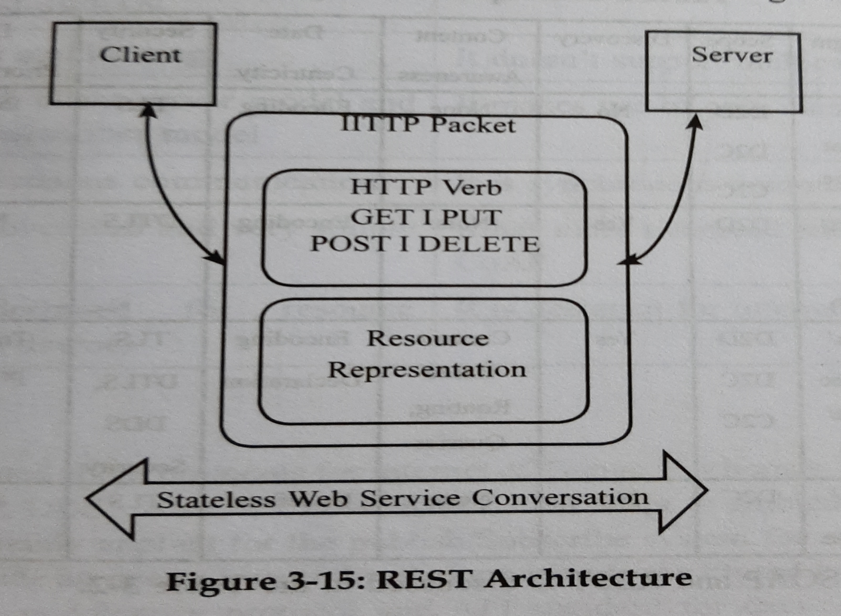
REST Architecture

Slide 13
Advantages of REST
Portability
Development team can scale the product without any problems
Flexibility
Used in open Internet/web

Slide 14
Case Studies of REST
Google glass Mirror API

